Slide 1


ANL488
Business Analytics Applied Project
Sustaining Competitiveness:
Comparative Study of Guest Experiences
in Singapore's Luxury Hotel Sector
PRESENTED BY:
Rebecca Gay

Slide 2


01 | Introduction
02 | Literature Review
03 | Data Understanding and Preparation
04 | Modelling and Evaluation
05 | Model Deployment
06 | Recommendations
07 | Limitations and Future Work
Overview
er

Slide 3
01 | Introduction
02 | Literature Review
03 | Data Understanding and Preparation
04 | Modelling and Evaluation
05 | Model Deployment
06 | Recommendations
07 | Limitations and Future Work
Overview
er

Slide 4


Introduction
Singapore's Luxury Hotel Landscape
Singapore aims to be a premier global destination
Singapore Tourism Board recognises luxury hotels as a core pillar of tourism and business travel.
Online Hotel Reviews
Reviews shape consumer decisions and hotel reputation
Understand strengths, weaknesses and service gaps of hotel brands

Slide 5
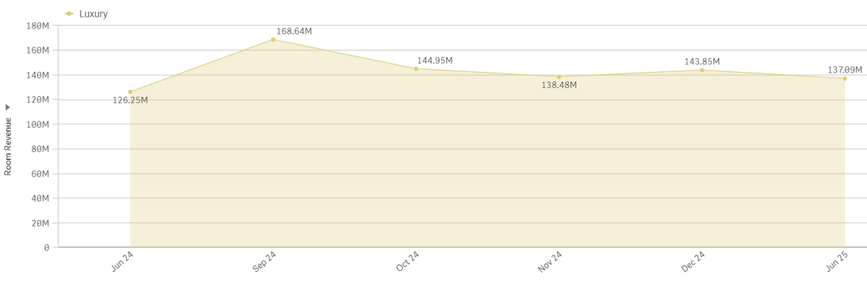

Business Problem
According to STB,
Room revenue decreased by 16.6% from Sep 2024 to Jun 2025 despite strong occupancy (~ 80-83%)
RevPAR decreased by 19% over the 10 months
By:
Identifying key service drivers
Addressing recurring complaints
Improve service quality and offerings
Objective
Increase room revenue by 20%

Slide 6
Business Analytics Goal
Apply sentiment analysis to derive and classify sentiments
Apply topic modelling to uncover key service aspects
Link sentiment with topics to identify key drivers of satisfaction and dissatisfaction
Goal #1
Understand customer sentiments and drivers
Train machine learning models to predict review sentiments
Evaluate model performance using accuracy and ROC-AUC
Goal #2
Enhance decision-making

Slide 7



Literature Reviews
 | Baouchi, 2024 London Hotels | Nguyen et al., 2025 Vietnam Hotels | Nlemuzor, 2024 Irish Hotels
Aim | Predict sentiments and key drivers of expensive and budget hotels | Uncover key determinants of guest satisfaction | Evaluate multiple ML classifiers for sentiment polarity classification
Sentiment Analysis | Lexicon-based scoring to classify polarity and validate satisfaction | TextBlob polarity & subjectivity scores to distinguish opinion-based vs. factual reviews | RoBERTa to capture semantic meaning and context
Topic Modelling | PCA on document–term matrix to identify latent factors | LDA used to extract themes of key satisfaction drivers | Not conducted
Predictive Modelling | Logistic Regression (LR), Decision Trees & Random Forest (RF) to predict sentiments | Not conducted | LR, RF, Naïve Bayes & Support Vector Machine (SVM) to predict sentiments
Limitations | 👎 Dataset limited to 20 hotels in London 👎 Relied on only English-reviews | 👎 Relied on only English-reviews 👎 Without predictive modelling, insights are not forecastable | 👎 Without topic modelling, insights lack specific service aspects that drive satisfaction and dissatisfaction

Slide 8
01 | Introduction
02 | Literature Review
03 | Data Understanding and Preparation
04 | Modelling and Evaluation
05 | Model Deployment
06 | Recommendations
07 | Limitations and Future Work
Overview
er

Slide 9
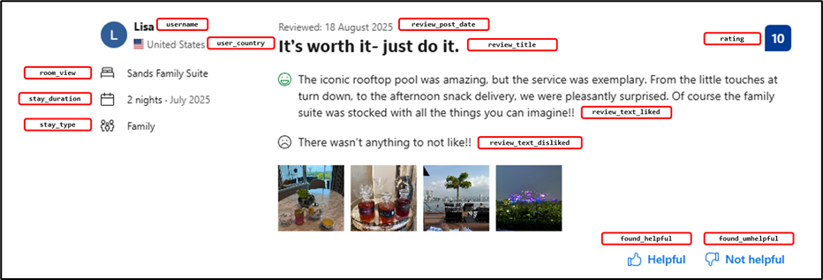
Data Collection & Understanding
Source: Booking.com
Data: Reviews from top 15 luxury hotels in Singapore
Method: Open-source web scraper using Python with self-enhancements
Total records: 19,996
Total attributes: 16

Slide 10
Data Preparation
Data Cleaning
Hotel Data
Structured Data
Concatenate title, positive and negative reviews
Remove duplicates
Keep relevant columns
Discretisation of ratings
Reformat date
Handle missing values
Text Pre-processing
Textual Reviews
Tokenisation and removal of punctuations
Filter English reviews
Case normalisation
Removal of stopwords
Lemmatisation
Part-of-speech tagging
Removal of empty tokens and stripping of whitespaces

Slide 11
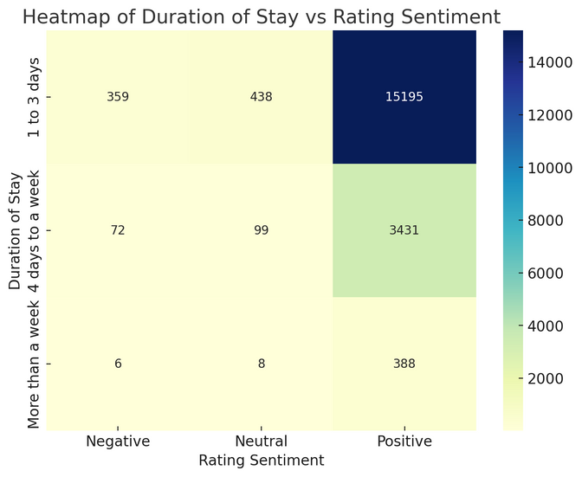
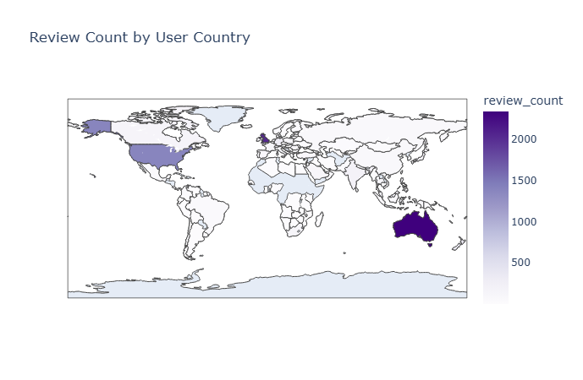
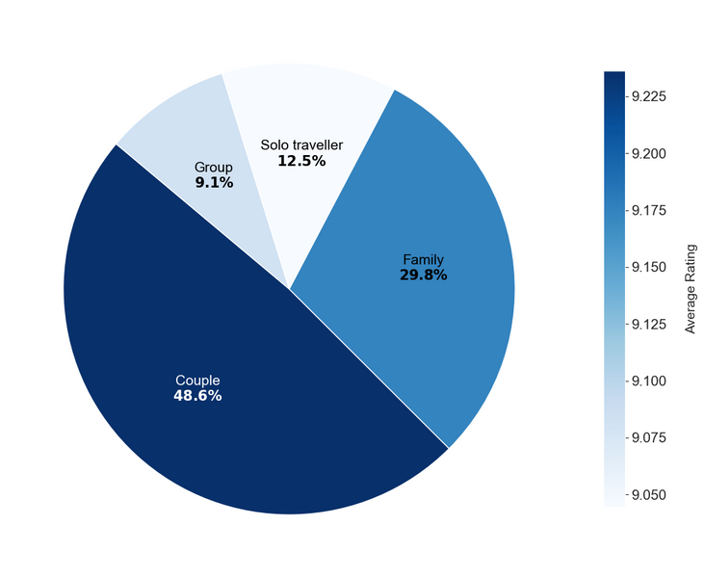
EDA - Customer Demographics
Duration of Stay vs Ratings
Most guests are short-term travelers
Long-term stays are rare but guests are still highly satisfied
Positive reviews dominate across all stay durations
Guest Residency Distribution
Guests came from 150 different countries
Most travelers came from Australia, UK and USA
Fewer from neighbouring ASEAN countries like Malaysia
Stay Type vs Ratings
Couples dominate luxury hotel stays and have the highest average rating
Solo travelers form the third largest group but have the lowest average rating

Slide 12
01 | Introduction
02 | Literature Review
03 | Data Understanding and Preparation
04 | Modelling and Evaluation
05 | Model Deployment
06 | Recommendations
07 | Limitations and Future Work
Overview
er

Slide 13

Modelling Techniques
Sentiment
Analysis
VADER using raw textual reviews
TextBlob using cleaned textual reviews
Topic Modelling
Latent Dirichlet Allocation (LDA)
n-grams such as
bi-grams and tri-grams
Predictive Modelling
Logistic Regression
Random Forest
XGBoost
Prediction of sentiment and topics from review input
Interactive Dashboard
Interactive
Charts
Performance metrics

Slide 14
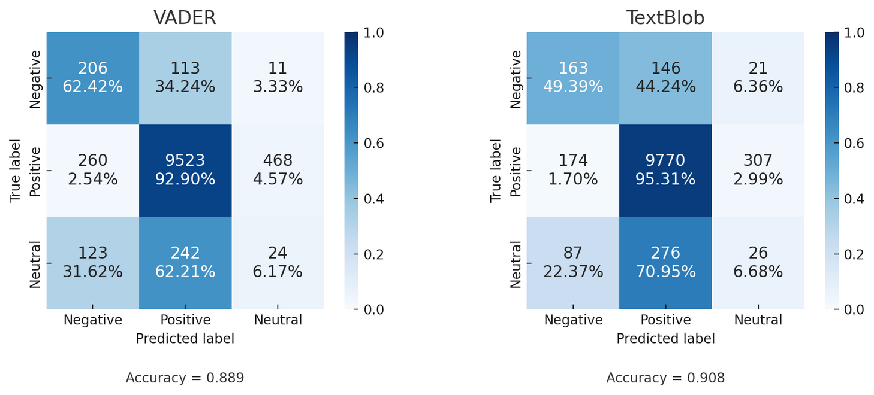
Sentiment Analysis
Comparison of Techniques
1
TextBlob
Python Package: textblob
Lexicon-based NLP tool for polarity and subjectivity
2
VADER
TextBlob has higher overall accuracy than VADER
Positive reviews: Both models perform very well, with TextBlob having higher recall than VADER
Negative reviews: Compared to TextBlob, VADER has higher recall but lower precision
To identify negative feedback for improving revenue: VADER is used
Python Package: nltk.sentiment.vader
Lexicon and rule-based tool to capture emotional intensity

Slide 15
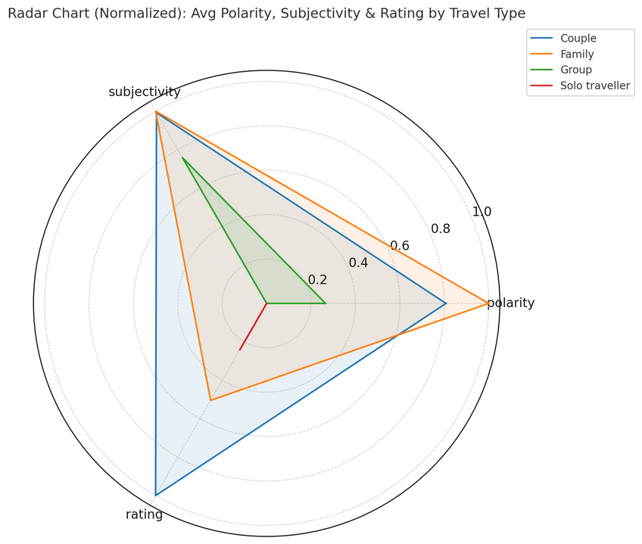
Sentiment Analysis
Results
1
TextBlob
Python Package: textblob
Lexicon-based NLP tool for polarity and subjectivity
2
VADER
Python Package: nltk.sentiment.vader
Couples: Strongly positively and expressive, with high ratings
Families: Positive and expressive, but slightly lower ratings
Groups: Moderately subjective, less positive and lower ratings
Solo Travelers: Least satisfied with lowest polarity, subjective and ratings
Lexicon and rule-based tool to capture emotional intensity

Slide 16
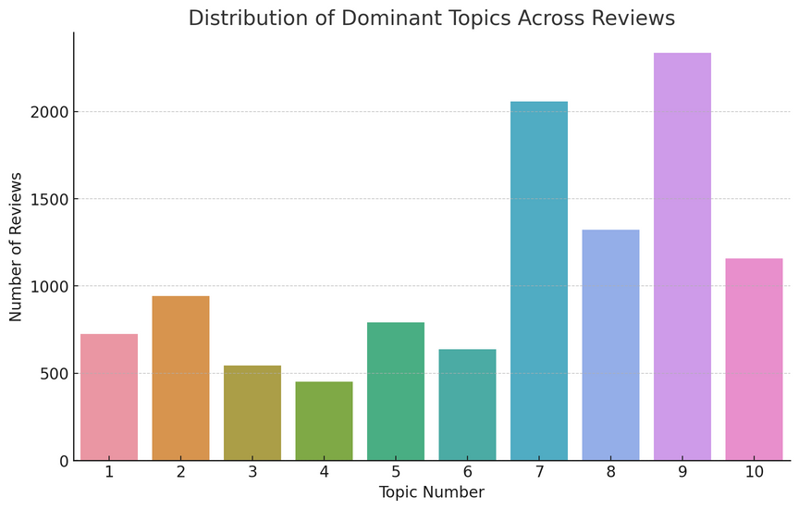
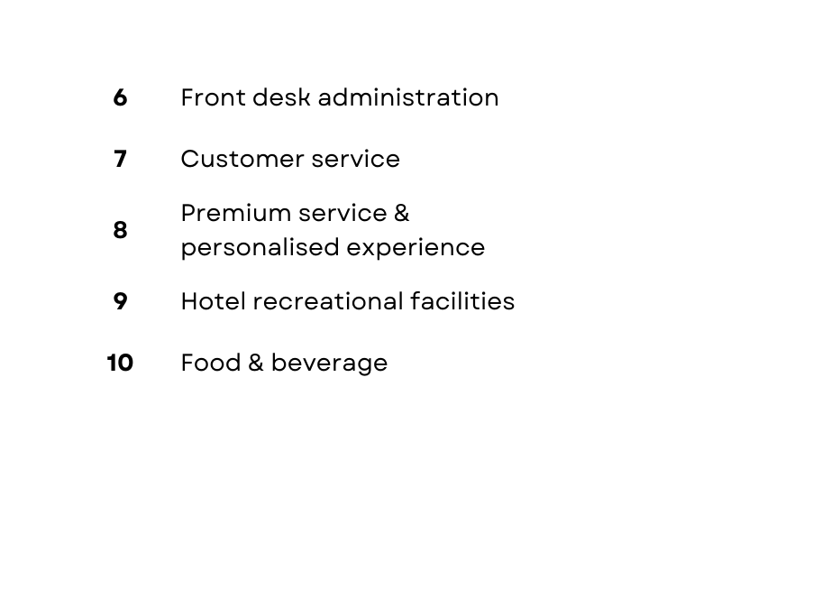
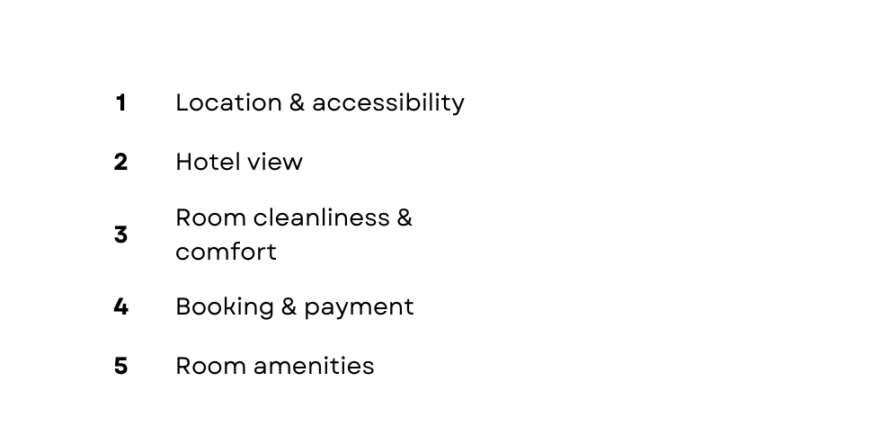
Topic Modelling
Results
1
Latent Dirichlet Allocation (LDA)
Python Package:
scikit-learn and pyLDAvis
Unsupervised machine learning technique to uncover hidden topics in text

Slide 17
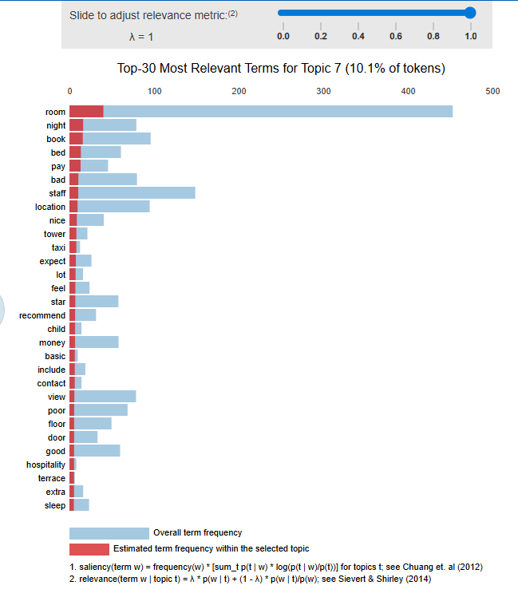
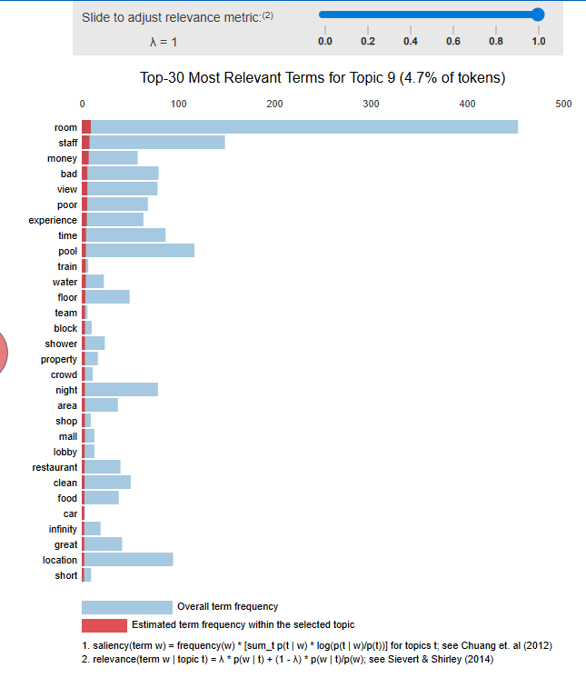
Topic Modelling
pyLDAvis - Topic 7 and 9 in Negative Reviews
Topic 7 - Customer Service
Frequent mentions
staff, room, pay, bad
Unhelpful staff & slow response times
Service mismatched with guest experiences
Topic 9 - Hotel Recreational Facilities
Frequent mentions
room, money, bad, pool, crowd
Overcrowding in shared facilities
Price mismatch with hotel quality

Slide 18
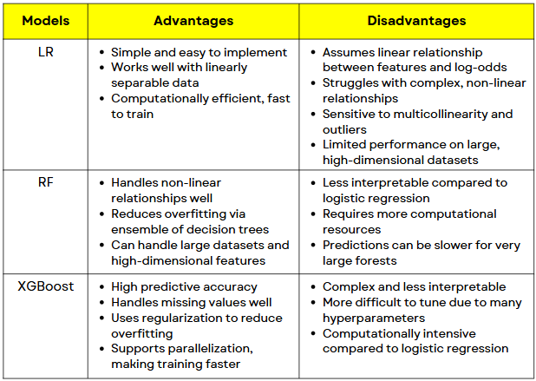
Predictive Modelling
1
Comparison - Advantages & Disadvantages
Logistic Regression (LR)
Python Module:
sklearn.linear_model.LogisticRegression
Supervised ML model for binary classification using sigmoid function
2
Random Forest (RF)
Python Module:
sklearn.ensemble.RandomForestClassifier
Ensemble model combining multiple decision trees
3
XGBoost
Python Module:
xgboost.XGBClassifier
Gradient boosting algorithm that builds decision trees sequentially

Slide 19
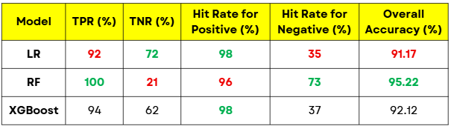
Predictive Modelling
1
Logistic Regression (LR)
Comparison - Performance Metrics
Python Module:
sklearn.linear_model.LogisticRegression
Supervised ML model for binary classification using sigmoid function
2
Random Forest (RF)
Python Module:
sklearn.ensemble.RandomForestClassifier
Ensemble model combining multiple decision trees
LR: Best trade-off between detecting positive and negative reviews despite lowest overall accuracy
RF: Highest overall accuracy and best at detecting positive reviews, but very poor in detecting negative reviews
XGBoost: Good balance between detecting positive and negative reviews, with stronger overall accuracy compared to LR
3
XGBoost
Python Module:
xgboost.XGBClassifier
Gradient boosting algorithm that builds decision trees sequentially

Slide 20
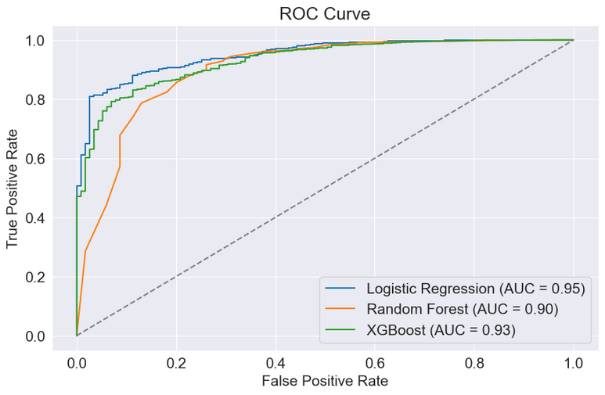
Predictive Modelling
1
Logistic Regression (LR)
Comparison - ROC-AUC
Python Module:
sklearn.linear_model.LogisticRegression
Supervised ML model for binary classification using sigmoid function
2
Random Forest (RF)
Python Module:
sklearn.ensemble.RandomForestClassifier
Ensemble model combining multiple decision trees
All models shows strong classification ability
LR: AUC = 0.96 → Strongest ability and best trade-off between sensitivity and specificity
RF: AUC = 0.90 → Strong performance, slightly lower than LR
XGBoost: AUC = 0.913 → Similar performance to RF, but better in showing true positive for lower false positives
3
XGBoost
Python Module:
xgboost.XGBClassifier
Gradient boosting algorithm that builds decision trees sequentially

Slide 21
Predictive Modelling
1
Logistic Regression (LR)
Comparison - OVERALL
Python Module:
sklearn.linear_model.LogisticRegression
LR is chosen as the better performing predictive model
Easy to implement and computationally efficient
Fast to train and practical for deployment
Transparent and interpretable
Allows hotel managers to clearly understand how different features influence sentiments
Balanced performance
Best trade-off between accuracy, TPR and TNR
Strong ROC-AUC
Reliable in detecting both negative and positive sentiments
Business value
Best at identifying areas of dissatisfaction
Allows targeted corrective actions
Supervised ML model for binary classification using sigmoid function
2
Random Forest (RF)
Python Module:
sklearn.ensemble.RandomForestClassifier
Ensemble model combining multiple decision trees
3
XGBoost
Python Module:
xgboost.XGBClassifier
Gradient boosting algorithm that builds decision trees sequentially

Slide 22
01 | Introduction
02 | Literature Review
03 | Data Understanding and Preparation
04 | Modelling and Evaluation
05 | Model Deployment
06 | Recommendations
07 | Limitations and Future Work
Overview
er

Slide 23
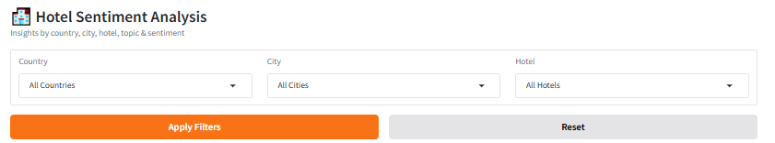
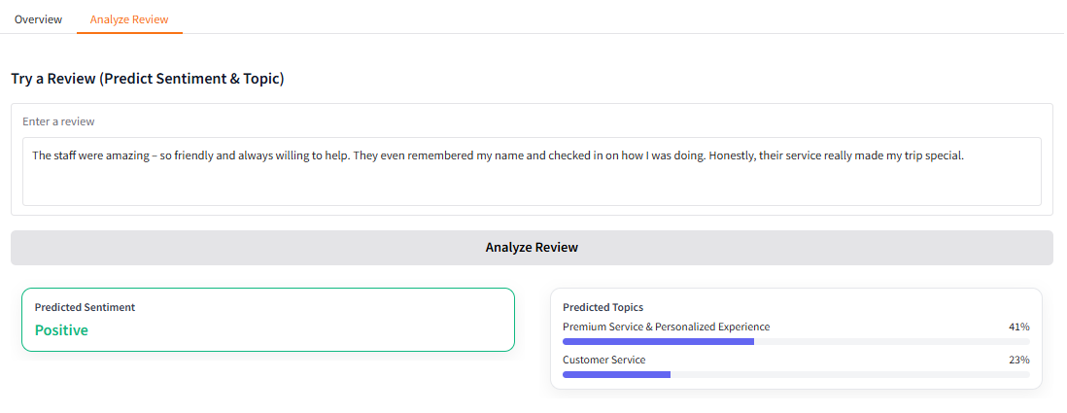
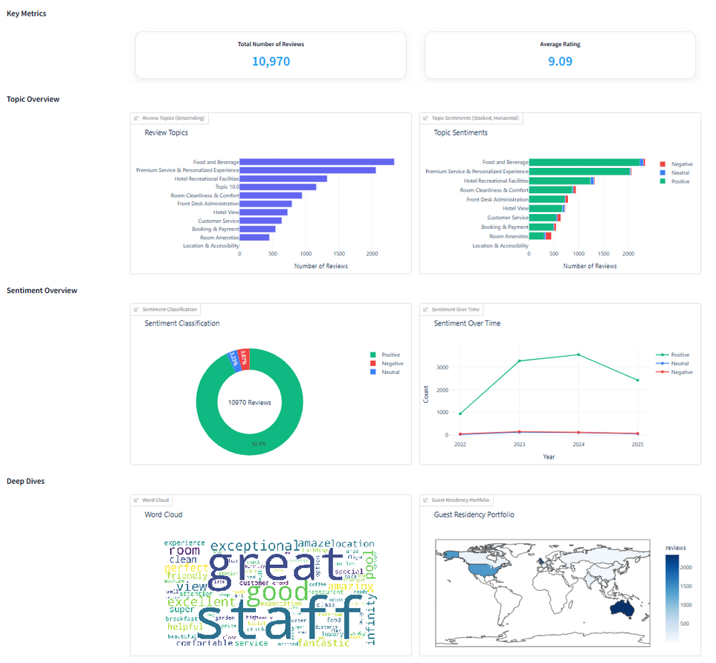
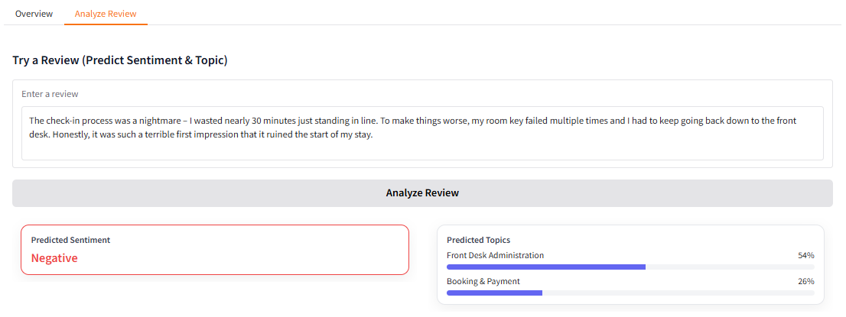
Deployment

Slide 24




Recommendations
Enhance Hotel
Recreational Facilities
Strengthen Customer
Service Standards
Tailor Service for
Solo Travelers
Align Pricing with
Perceived Service Quality
Reduce overcrowding in high-demand areas to improve guest comfort
Invest in physical expansion of facilities
Use digital signage or mobile apps to display real-time occupancy
Introduce wellness packages
In-room spa
Partner with SHATEC or SkillsFuture for regular staff training
Cross-cultural communication
Service recovery protocols
Conduct periodic service audits to evaluate
Staff attentiveness
Response and resolution
Increasing number of solo travelers
Introduce compact, premium single-occupancy rooms
Offer “Solo But Social” communal dining options
Guest complaints from:
Service lapses
Complimentary room upgrades
Late check-outs
Unjustified hotel costs
Partner with tour operators to bundle room stays with tour experiences

Slide 25

Limitations and Future Work
Limited Dataset &
Language Representation
Luxury Segment Bias
Lack of data
Risk of sampling bias
Unrepresentative modelling result
Focus only on luxury hotels in Singapore
Guest expectations and satisfaction drivers differ by hotel tiers
Limits generalisation to other hotel classes
Expand data scope from multiple third-party travel platforms like Tripadvisor
Conduct comparative analyses across multiple hotel segments
Only English reviews are included
Exclude diverse international perspective
Linguistic and cultural bias
Implement multilingual sentiment analysis like KoBERT

Slide 26



